Slide 1
Optical communications and data networks (EENGM2001)
Siddarth K Joshi

Slide 2
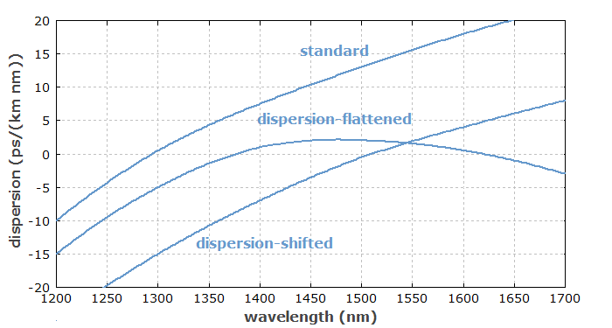
Dispersion: Recap
Zero dispersion is not good either. It results in nonlinear effects within the fibre (e.g. four wave mixing)
Dispersion shifted/flattened fibres have higher dopant concentrations. i.e. Higher loss
Choice of fibre is a trade-off between dispersion, loss and cost

Slide 3
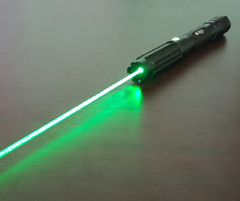
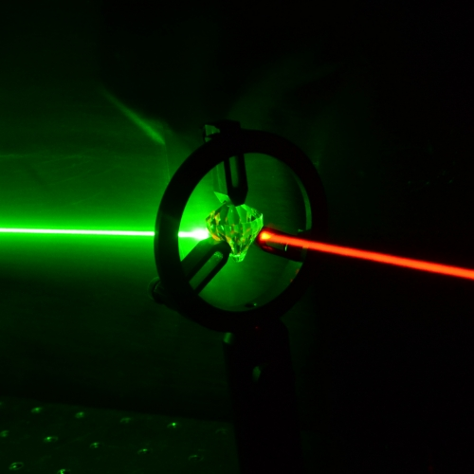
Nonlinear optics
3 wave mixing
4 wave mixing
Intensity dependent refractive index: Kerr, Pockels, Self phase modulation, Cross Phase modulation
Scattering

Slide 4




Nonlinear optics
P is the polarisation density of a dielectric media
Linear coefficient =
Refractive index n =
Consider electric field consisting of two frequencies
The first non linear term contains 5 components

Slide 5
Nonlinear optics
Mix 2 optical frequencies to generate a third: Three wave mixing
Many types:
Second Harmonic Generation
Sum/Difference Frequency Generation
Optical Parametric Amplification
Optical Parametric Generation
Optical Parametric Oscillator
Spontaneous Parametric Down Conversion

Slide 6
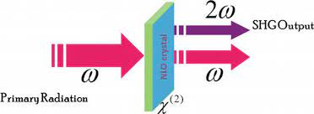
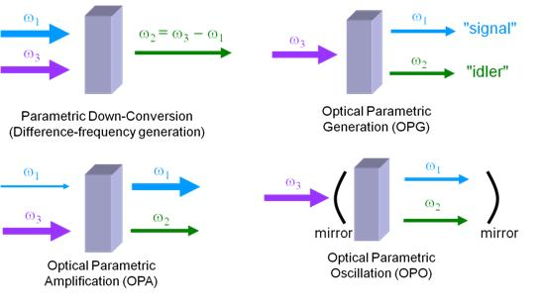
Nonlinear optics
All 3 wave processes involve 3 fields in different combinations of input & output
Second Harmonic Generation:
2 photons from the same pump combine to give a higher energy photon

Slide 7
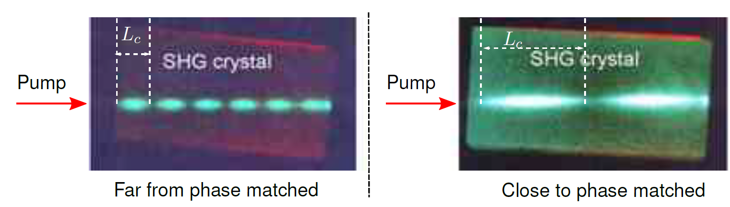
Nonlinear optics
Energy and momentum (wave vector) are conserved.
Result in Phase matching conditions

Slide 8
Nonlinear optics
When phase matched, the non linear process is constructive.
With dispersion phase matching is harder,
With zero dispersion we have many types of Non linear processes

Slide 9
Nonlinear optics
With perfect phase matching
With bad phase matching

Slide 10

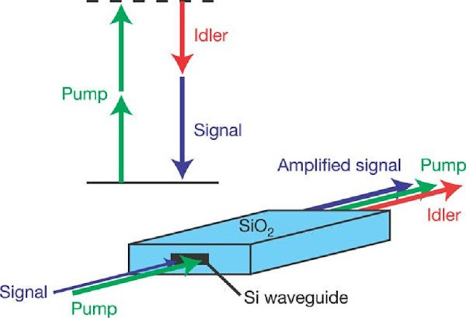
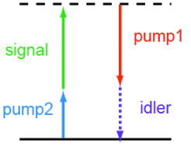
Nonlinear optics
Four wave mixing involves the component of P
Uses 4 frequencies
Used as an amplifier
Used as an optical gate

Slide 11
Nonlinear optics
degenerate FWM
Non-degenerate FWM
Stokes wave
‘Signal’
Anti-Stokes wave
‘idler’
ω₃
ω₁
ω₂
ω₄
ω
ω₃
ω₁=ω₂
ω₄

Slide 12
Nonlinear optics
FWM effects in WDM transmission
If Ε has 2 or more frequency components, then:
frequencies ω_{i}, ω_{j}, and ω_{k} will mix
generating new frequencies at ω_{i} ± ω_{j} ± ω_{k}
E.g., The term ω_{i} + ω_{j} - ω_{k} can be very harmful as they fall back into the WDM channels, resulting in crosstalk
ω₁
ω₂
ω₃
ω₁₁₃
ω₂₁₃
ω₂₂₃
ω₁₃₂
ω₂₂₁
ω₂₃₁
ω₃₃₁
ω₁₂₃
ω₃₁₂
ω₃₂₁
ω₁₁₂
ω₃₃₂

Slide 13
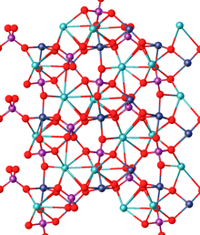
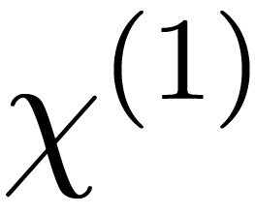
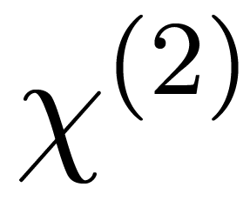
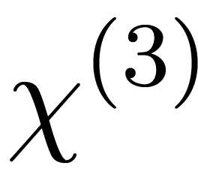
Nonlinear optics
The strength of the nonlinear process depends on the optical power, material properties, and volume in which interaction occurs.
Material properties depend on crystalline structure.
Is not isotropic
Each , , , ….. is actually a tensor
Oriented about the crystallographic axes.

Slide 14
Nonlinear optics
Effective Area of optical fibre
Fibre core/cladding boundary
Nonlinear effects are dependent on the local optical EM field amplitude, which is related to the optical power density or light intensity.
The optical field distribution in the fibre is not uniform – it extends outside of the fibre core.
So the core area is not a good parameter of calculating intensity
For certain power P, a effective intensity is defined as I_{e}=P/A_{e}, where A_{e} is the effective area.
Intensity distribution of/ fibre mode
core
cladding
R
R_{e}=(A_{e}/p)^{1/2}
Such that the optical power distributed uniformly over A_{e}, will cause the same amount of nonlinear effect as the real distribution.

Slide 15
Nonlinear optics
Example effective areas:
SMF: A_{e} ~ 85 mm² compared to core area of ~ 63 mm²
DSF: A_{e} ~ 50 mm², so it has higher nonlinearity than SMF
So when launch power = 0dBm (1 mW), the intensity (power density) is
1.18x10⁻⁵ W/ μm² in SMF,
and 2x10⁻⁵ W/ μm² in DSF. 10⁻⁵ W/um² = 10⁷ W/m².
Radiation power density on the surface of the Sun: 6.3 x 10⁷ W/m²

Slide 16
Nonlinear optics
Effective Length of optical fibre
As light propagates through fibre its power reduces due to fibre attenuation, so not the entire length is of the same importance to nonlinear effects
After a certain length the power is sufficiently low that nonlinear effects disappear, however longer the fibre is
Optical power attenuation coefficient in fibre is denoted by α.
The power distribution along the fibre length is exponentially decaying

Slide 17
Nonlinear optics
L_{e}
z
If the fibre length is L>>1/α, the effective length is simply decided by the value of α (1/km)

Slide 18
Nonlinear optics
α is related to fibre loss (dB/km) by
or
Hence, when fibre loss = 0.22 dB/km

Slide 19
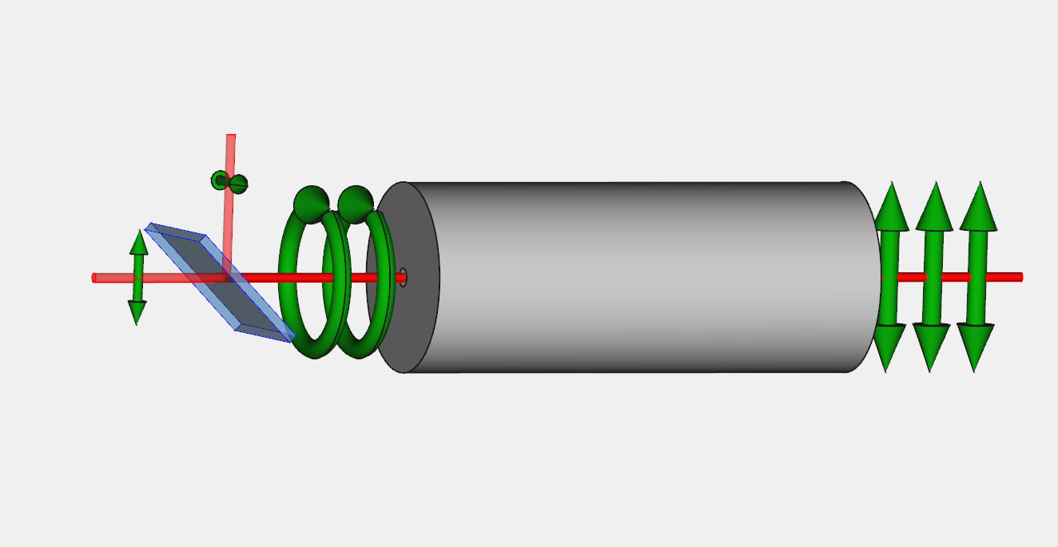
Pockels effect
Is a linear electro optic effect
Changes the polarisation of light in the presence of an electric field
Works like an EOM

Slide 20

Kerr Effect
Is the non-linear electro optic effect
Two types
Kerr electro-optic effect, or DC Kerr effect,
Optical Kerr effect, or AC Kerr effect
Self-focusing
Self-phase modulation
Modulational instability
Cross Phase Modulation
Kerr-lens mode-locking
Material becomes birefringent with difference in refractive index of
External E field applied
Due to the light field itself
Variation of Refractive index proportional to irradiance

Slide 21

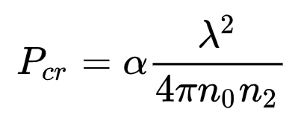
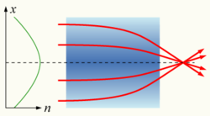
Kerr Effect: Self Focusing
If n₀ and n₂ are the linear and non-linear components of the refractive index
Total change in refractive index n with intensity I is
Self focusing occurs beyond a threshold power
For a gaussian beam α = ~ 1.89,
For Air P_{cr} = 2.4GW
For Silica P_{cr} = ~2.8MW
n2 typically ~ 2.2 – 3.4 x 10-8 mm²/W
I=P/A_{e}.
Seems very high, but pulsed fs lasers can easily reach these peak powers

Slide 22
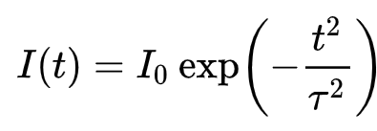
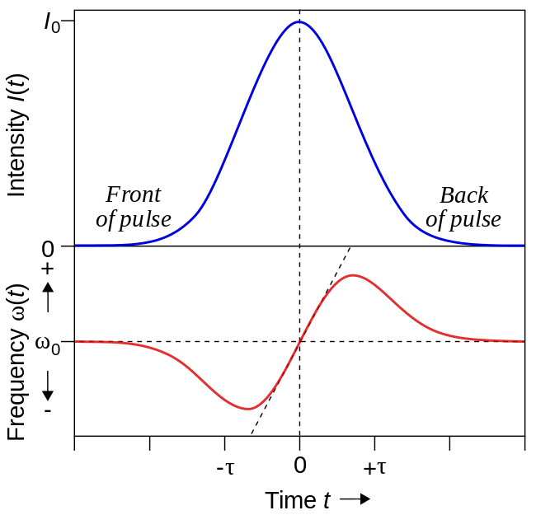
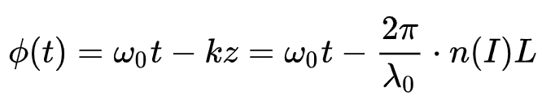
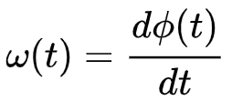
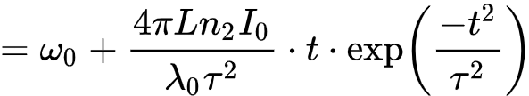
Kerr Effect: Self Phase Modulation
Short Gaussian pulse of FWHM 2τ has intensity
Creates time varying intensity and hence refractive index
This results in a phase shift after length L of
In turn the frequency shift is

Slide 23
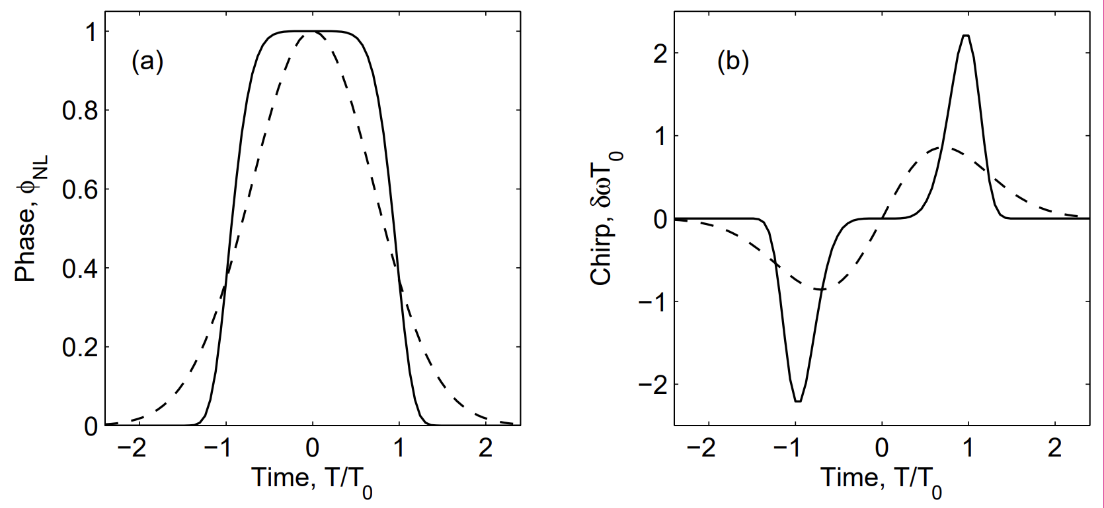
Kerr Effect: Self Phase Modulation

Slide 24
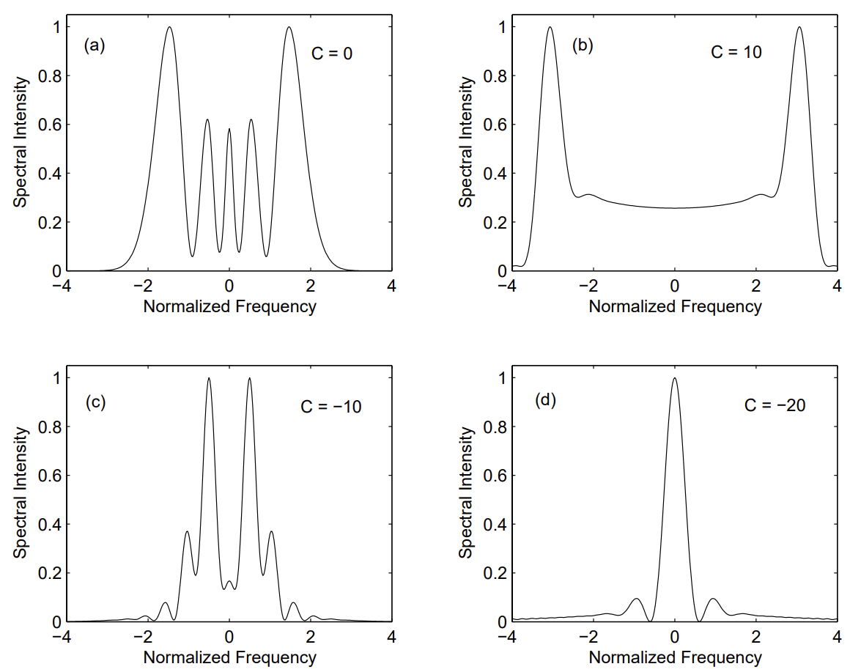
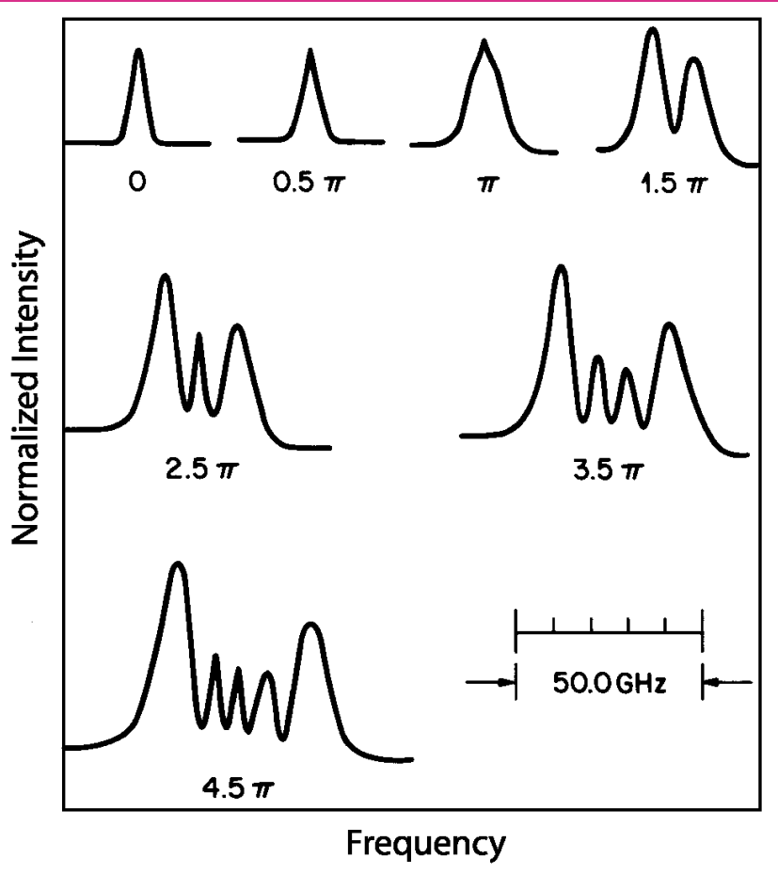
Kerr Effect: Self Phase Modulation
Chirped Gaussian pulses with
A(0,t) = A₀ exp[− 1/2 (1+iC)(t/T₀)² ].

Slide 25
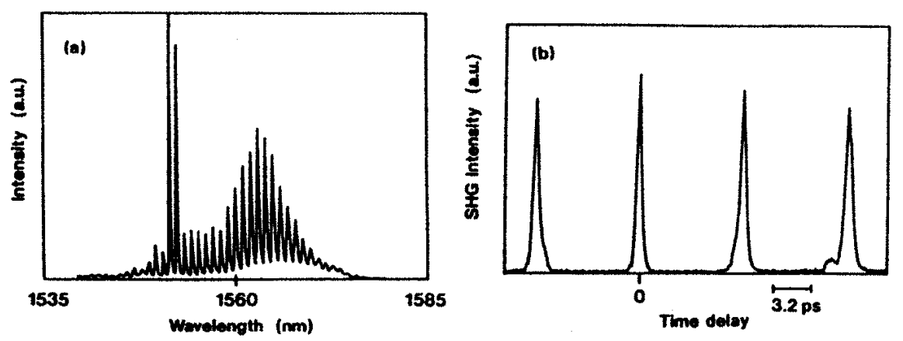
Kerr Effect: Modulational instability
A CW beam can be converted into a pulse train.
Two CW beams at slightly different wavelengths can initiate modulation instability and allow tuning of pulse repetition rate.
Repetition rate is governed by their wavelength difference.
Repetition rates ∼100 GHz realized by 1993 using DFB lasers (Chernikov et al., APL 63, 293, 1993)
Repetition rates ∼100 GHz realized by 1993 using DFB lasers (Chernikov et al., APL 63, 293, 1993)

Slide 26
Kerr Effect: Cross Phase Modulation (XPM)
In WDM systems the total power is actually quite high because of number of channels
Induce phase changes on each other
XPM requires that the channels have the same group velocity,
otherwise the pulses will ‘walk-away’ therefore XPM disappears.
This is usually the case with SMF at 1550nm
However DSF can maintain same group velocity for pulses in different channels because the near zero dispersion D, hence XPM can be significant.
A reason DSF is not good for WDM transmission!
λ₁
t
t
λ₂
t
t
z

Slide 27
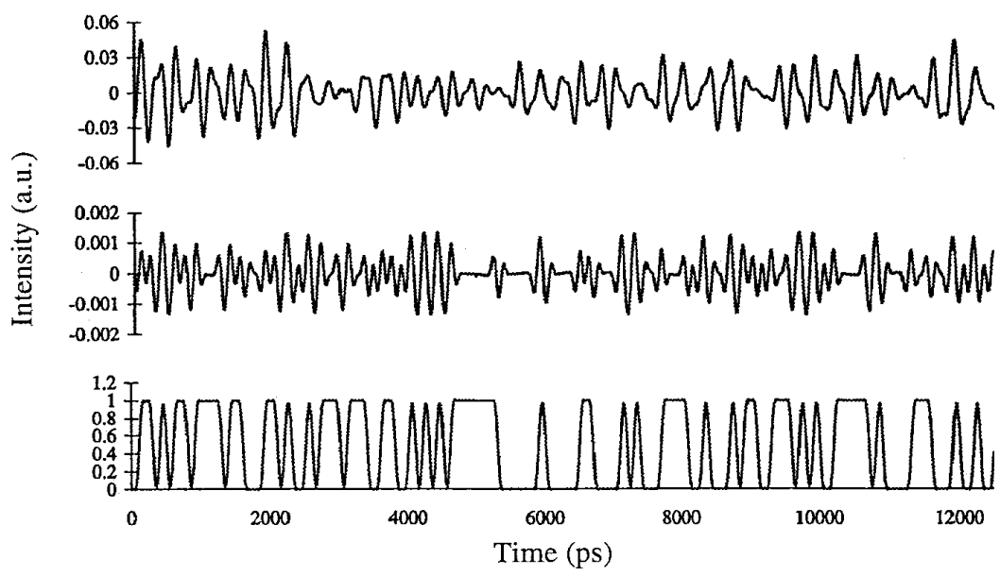
Kerr Effect: Cross Phase Modulation (XPM)
E.g., What happens to an unmodulated CW beam going along with OOK signals?
After 320km
After 130km
10 Gbps OOK Channel

Slide 28
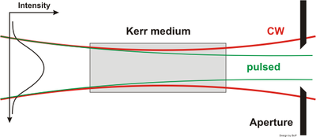
Kerr Effect: Kerr-lens mode-locking
Creates strong fs pulsed lasers
If the beam is not pulsed then it has a lower peak power so is not Kerr lensed
If it has the right focusing, it will exit the cavity
Up to 40 GHz repetition rate

Slide 29
Nonlinear optics
Summary: NLO has amazing applications
Imposes many limits on communication
Major field of study

Slide 30
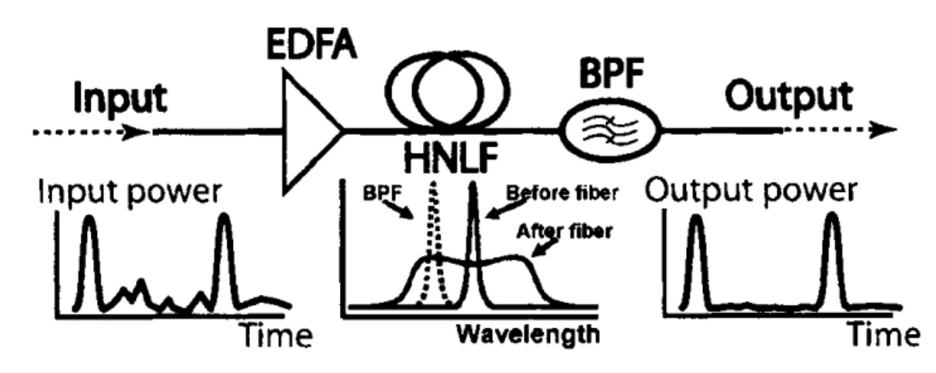
Nonlinear optics: Optical regenerators
Use Highly Non linear fibers to help regenerate signal without using relays
https://www.fiberoptics4sale.com/blogs/wave-optics/optical-regenerators

Slide 31
Problems
Given the following constraints, what is the longest distance over which an NRZ OOK protocol can have at least 1Gbps of data rate.
Up to 20 EDFAs each with:
Min input power = -20dBm
Max input power = 0dBm
Tuneable gain <=40 dBm
Noise figure = 3.8dBm
1 units of OOK transmitters
with 10 dBm transmit power, 1 Gbaud/s and a transmit noise of -20dBm
1unit of OOK receivers:
0.4A/W responsivity 0.5nA of dark current and 5E-12 W/Sqrt(Hz) NEP, max bandwidth is 10GHz
Optical fibre:
SM, 0.2dB/Km,
No loss when connecting any other components.
Last Tuesday we did not consider adding Raman amplifiers
Assume that the EDFAs are equally spaced and there is no additional EDFA before the receiver. Further assume that the maximum desirable launch power is 10dBm.
Will adding more EDFAs help improve the distance?

Slide 32
Problems
Max launch power is 10 dBm and min receive power for next EDFA is -20dBm, So a max loss of 30dB is permitted.
At 0.2dB/km, we can have upto 150 km between EDFAs
With -20dBm of transmit noise, the best SNR of the transmitter becomes 10mW/10uW => SNR = 1,000 or 30dB.
When each EDFA has 3.8 dB Noise Factor. We can have int(30/3.8) = 7 EDFAs in the total length
150km*7 = 1050km
The 40dB gain of the EDFA is more than enough to boost the launch power back to 10dBm from -20dBm

Slide 33
Problems
But the detector is sensitive up to:
Total noise in detector: 0.5nA + Sqrt(Bw)* 5E-12*0.4. The bandwidth is 1 GHz (since that is the transmit bandwidth) =63.7nA.
To be detected the signal must be > noise. So we need a signal strength of 63.7nA/0.4A/W = 1.59E-7 nW = -37.9dBm or more.
That means an additional -37.9/0.2 = 189.5km of fibre would be ok.
Total length = 1050+189.5 = 1,239.5 km
Normally we would want a better SNR but if it is not specified we can go with the bare minimum of 1

Slide 34
Problems
Will adding more EDFAs help?
No. There is already too much noise from the EDFAs
If I could place Raman amplifiers with a gain of 15dB and effective NF of -1 along with each EDFA, how much longer could the total span be?

Slide 35
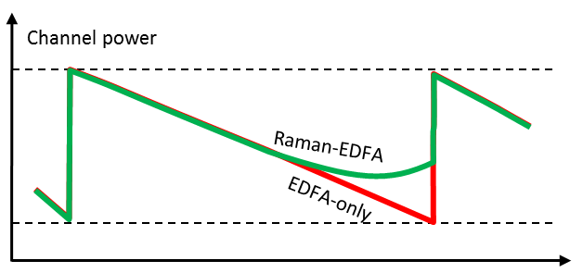
Problems
With a Raman amplifier in place, the power before the EDFA is increased by 15dB
So that’s an additional 15/0.2 = 75 km between each EDFA.
Additionally the Raman amplifier would reduce the NF of each EDFA by 1dB
When each Raman-EDFA pair has (3.8-1) dB Noise Factor. We can have int(30/2.8) = 10 Raman-EDFA pairs in the total length
So the total fibre distance can be 10*(150+75)+189.5 = 2439.5 km
Wow, almost double!

